Slide 1
Unit 4 (LH 2)

Slide 2
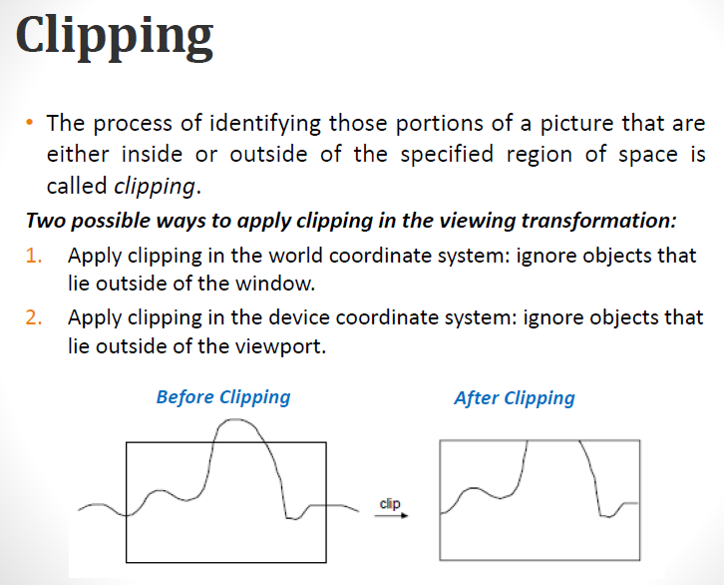

Slide 3
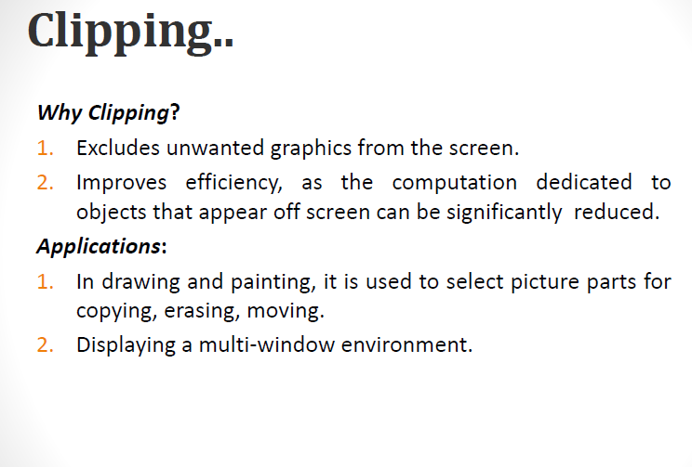

Slide 4
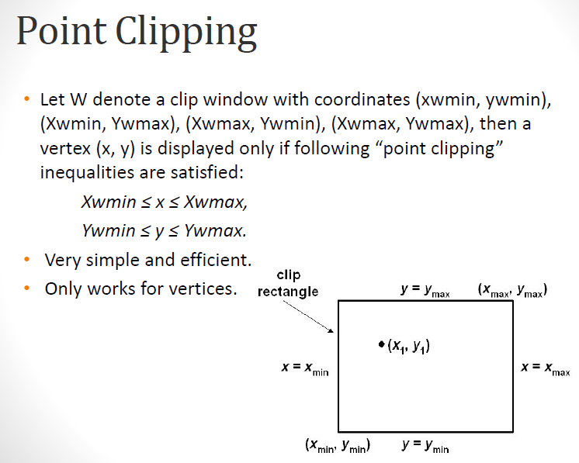

Slide 5
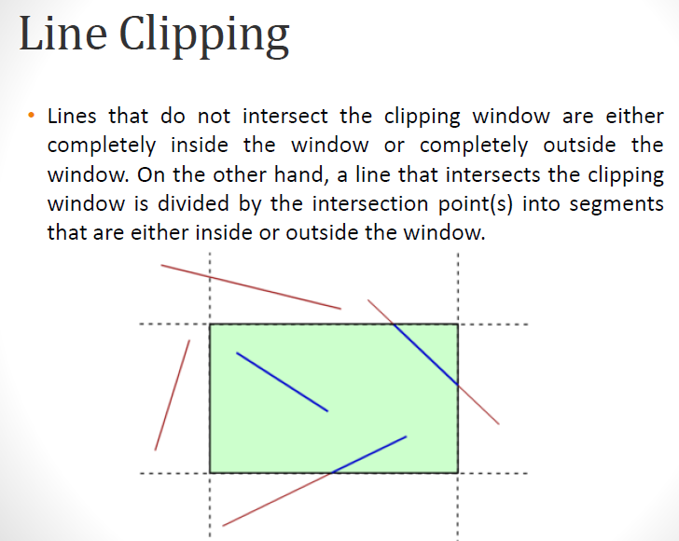

Slide 6
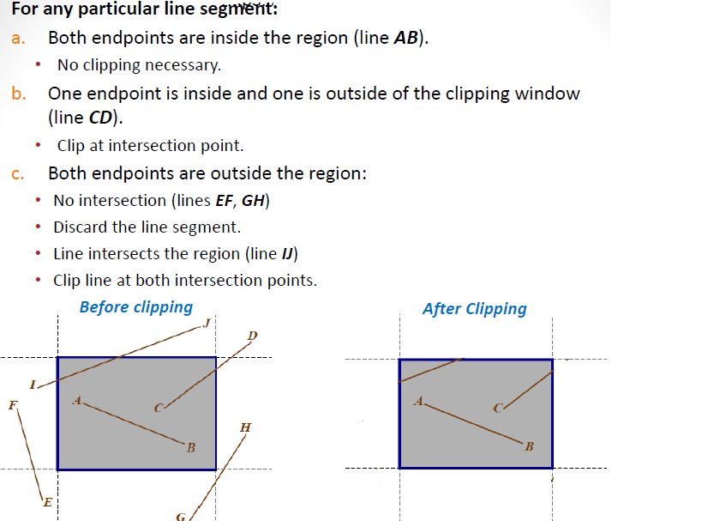

Slide 7
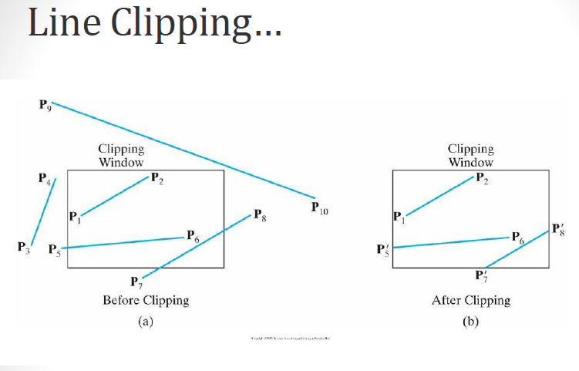

Slide 8
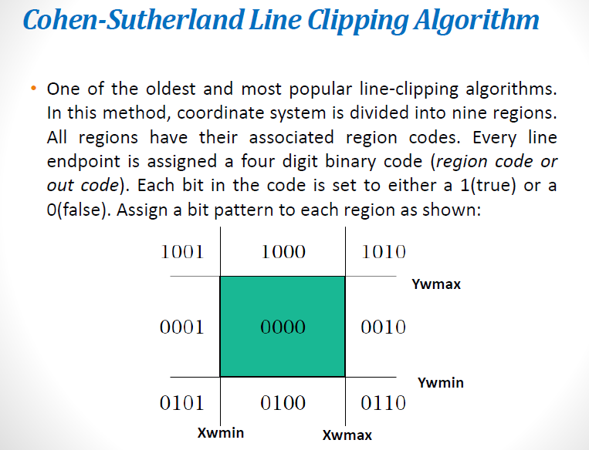

Slide 9
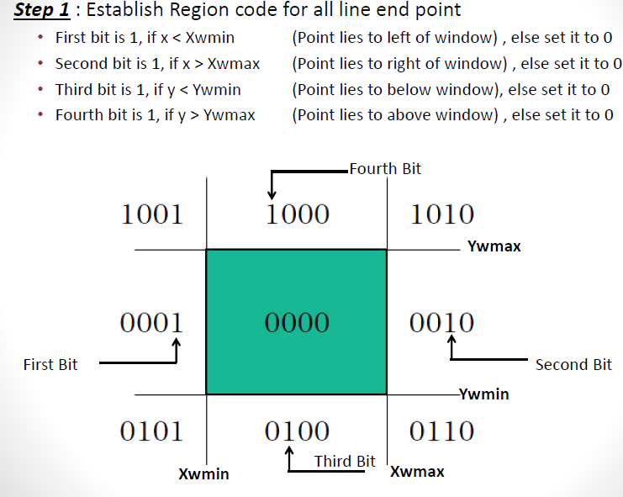

Slide 10
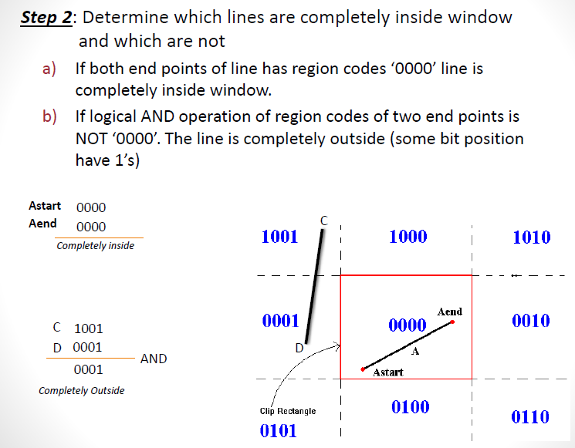

Slide 11
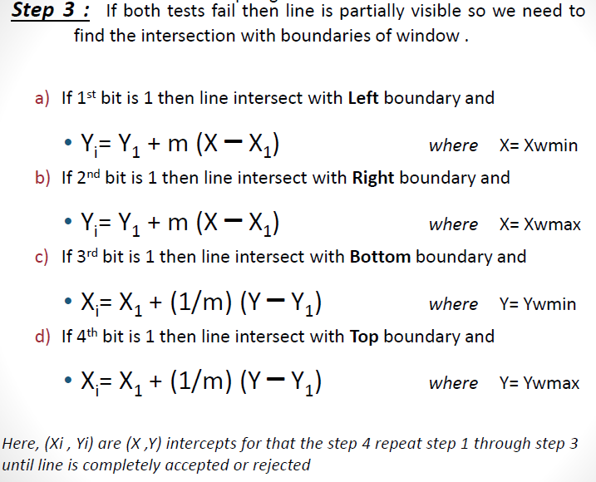

Slide 12
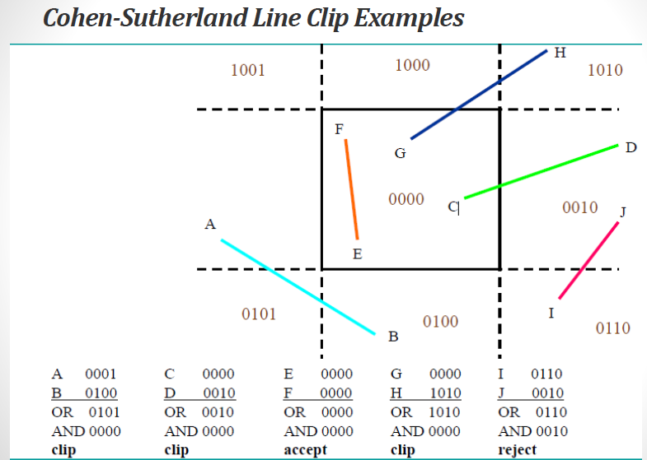

Slide 13
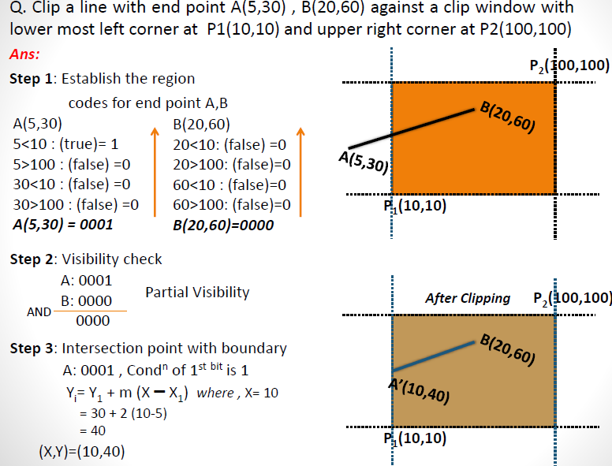

Slide 14
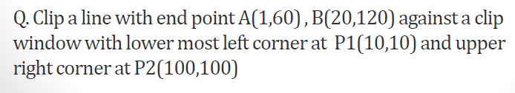

Slide 15
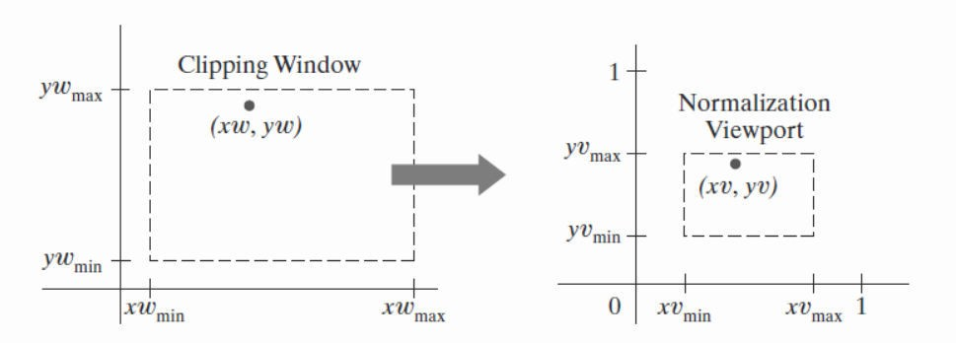
Window to View port Coordinate Transformation
A window can be specified by four world coordinates: xwmin, xwmax, ywmin and ywmax.
Similarly, a view port can be described by four device coordinates: xvmin, xvmax, yvmin and yvmax

Slide 16
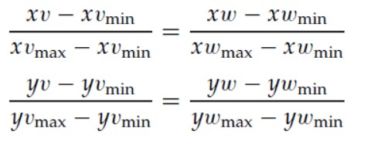
The following proportional ratios must be equal.
Solving these expressions, we get
xv= xvmin + (xw - xwmin)Sx
yv= yvmin + (yw- ywmin)Sy

Slide 17
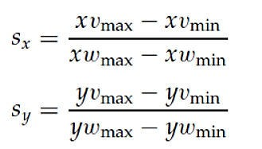
Where,

Slide 18
Q. Window port is given by (100,100,300,300) and view port is given by (50,50,150,150). Convert the window port coordinate (200,200) to the view port coordinate.
Solution:
(xwmin, ywmin) = (100, 100)
(xwmax, ywmax) = (300, 300)
(xvmin, yvmin) = (50, 50)
(xvmax, yvmax) = (150, 150) (xw,yw)=(200,200)
Then, we have

Slide 19
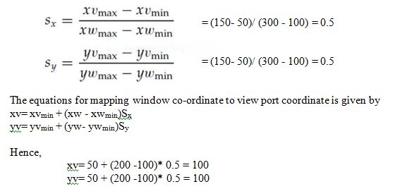
The transformed view port coordinate is (100,100).

Slide 20
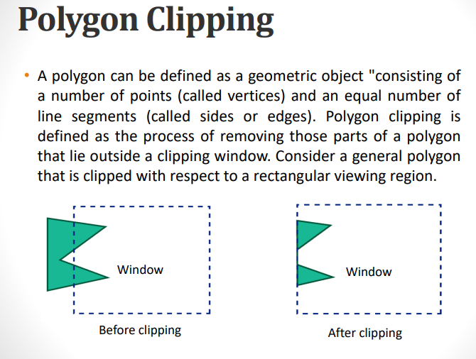

Slide 21
